Slide 1
Welcome!
‹#›
Notes:
Updates - add quick example of raising your own exception (maybe add that section back into the book), also, can you raise a general exception like in Java?

Slide 2


2.4 Managing Complexity
PROFESSOR RAMSEY
ramsey@cs.utexas.edu
Notes:
too short 20 min long
fix slide 13
move mirror example to a day before they do UT Longhorn

Slide 3
Announcements
TBD

Slide 4
2.4
Managing
Complexity
Notes:
Session Title: Project Based Learning (PBL) for Equity in CS classes
Session Description: If you are teaching a survey course like Computer Science Principles, or a code intensive course like AP CS A, PBL can serve as a powerful tool to increase student interest and engagement. Learn about research that connects PBL to improved student outcomes, especially for girls and underrepresented minorities. Discover available PBL resources and understand PBL lesson components, so you can build your own.

Slide 5
Strategies for Managing Complexity
Draw on paper.
Design the program before you code using pseudocode: English descriptions of the text.
Limit variable scope.
Create Loop Tables to find patterns.
‹#›

Slide 6
Decomposition Step 1
Write pseudocode to draw this shape. Start with the top level of decomposition.
  #================#
  | <><> |
  | <>....<> |
  | <>........<> |
  |<>............<>|
  |<>............<>|
  | <>........<> |
  | <>....<> |
  | <><> |
  #================#
‹#›

Slide 7
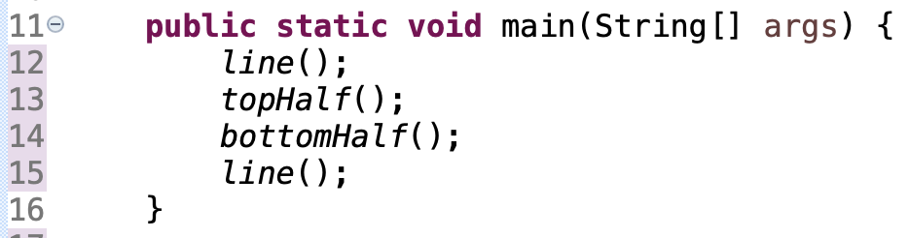
Result
1
  #================#
  | <><> |
  | <>....<> |
  | <>........<> |
  |<>............<>|
  |<>............<>|
  | <>........<> |
  | <>....<> |
  | <><> |
  #================#
draw line
draw top half
draw bottom half
draw line
2
3
4
‹#›

Slide 8
Decomposition Step 2
Be a detective and gather information about #2, top half. Write enough detail so if you read it aloud to someone on the phone, they could recreate the characters.
1
  #================#
  | <><> |
  | <>....<> |
  | <>........<> |
  |<>............<>|
  |<>............<>|
  | <>........<> |
  | <>....<> |
  | <><> |
  #================#
2
3
4
‹#›

Slide 9
Result
  #================#
  | <><> |
  | <>....<> |
  | <>........<> |
  |<>............<>|
  |<>............<>|
  | <>........<> |
  | <>....<> |
  | <><> |
  #================#
print “|”
print spaces (decreasing)
print “<>”
print dots (increasing)
print “<>”
print spaces (same # as above)
print “|”
a
b
c
d
‹#›

Slide 10
Remember Patterns in Math Class?
0 ____ 10 _____ 20
21 ____ 35 ____ 49 56
‹#›

Slide 11
The Loop Table - Top Half
Using a table, start with what we know. Figure out the rest.
  | <><> |
  | <>....<> |
  | <>........<> |
  |<>............<>|
SIZE | Line | Spaces | Math | Dots | Math
4 | 1 | 6 |  | 0
 | 2 | 4 |  | 4
 | 3 | 2 |  | 8
 | 4 | 0 |  | 12
Patterns:
spaces get smaller as line gets bigger
spaces get further apart faster
Patterns:
lines and dots increase together
dots increase much faster
(-2 * line) + 8 (line - 1 ) * 4
‹#›

Slide 12
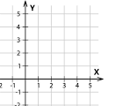
Slope-Intercept
Use algebra and a coordinate plane to solve for missing value.
  | <><> |
  | <>....<> |
  | <>........<> |
  |<>............<>|
Line (x) | Spaces (y) | Math
1 | f(1) = 6 | y = mx + b slope (m) = -2 6 = -2(1) + b 8 = b y = -2x + 8 num_spaces = (-2 * line) + 8
2 | f(2) = 4
3 | f(3) = 2
4 | f(4) = 0
‹#›

Slide 13
Demo
MirrorStart.java
Write topHalf()

Slide 14
The Loop Table - Bottom Half
  |<>............<>|
  | <>........<> |
  | <>....<> |
  | <><> |
Line | Spaces | Math | Dots | Math
1 | 0 |  | 12
2 | 2 |  | 8
3 | 4 |  | 4
4 | 6 |  | 0
(line - 1) * 2 (num_lines - line)* 4
‹#›

Slide 15
Demo
MirrorStart.java
Write topHalf()

Slide 16
Scaling the Mirror
Modify the Mirror program so that it can scale.
The current mirror (left) is at size 4; the right is at size 3.
Want to change size in only one place.
How do you choose what SIZE should be (4, 8 or 10)?
  #================#
  | <><> |
  | <>....<> |
  | <>........<> |
  |<>............<>|
  |<>............<>|
  | <>........<> |
  | <>....<> |
  | <><> |
  #================#
  #============#
  | <><> |
  | <>....<> |
  |<>........<>|
  |<>........<>|
  | <>....<> |
  | <><> |
  #============#
‹#›

Slide 17
Demo
MirrorStart.java
Experiment with SIZE

Slide 18
Patterns
Pattern for Two Variables | Related Algebra
moving in opposite directions | multiply by a negative
moving at different rates | multiply or divide
starting in different places | add or subtract

Slide 19
2.5
Case Study
Optional Practice
Notes:
Session Title: Project Based Learning (PBL) for Equity in CS classes
Session Description: If you are teaching a survey course like Computer Science Principles, or a code intensive course like AP CS A, PBL can serve as a powerful tool to increase student interest and engagement. Learn about research that connects PBL to improved student outcomes, especially for girls and underrepresented minorities. Discover available PBL resources and understand PBL lesson components, so you can build your own.

Slide 20
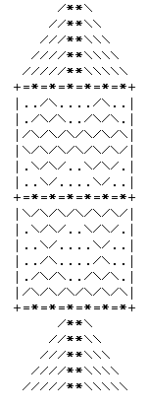
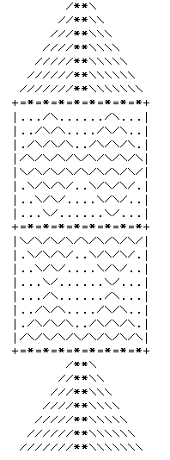
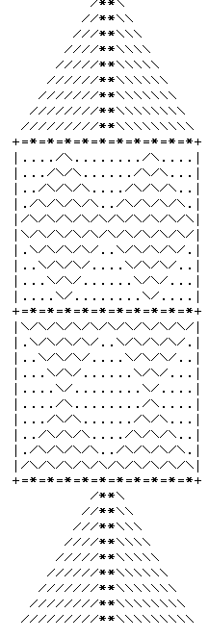
A
r
t
R
o
c
k
e
t
Size = 3 Size = 4 SIZE = 5
‹#›

Slide 21
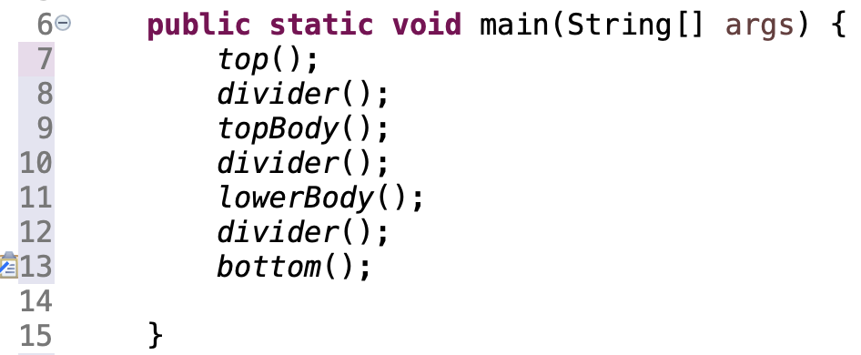
Top Level Decomposition
1
What does main() look like?
2
3
4
5
6
7

Slide 22
Top Loop Tables
Vertical (line/row) Math
Size | Lines | Math
3 | 5 | SIZE * 2 - 1
4 | 7
5 | 9
SIZE = 3 SIZE = 4
Horizontal (column) Math, SIZE = 3
Line | Spaces | Math | Slashes | Math
1 | 5 | (SIZE * 2) - line | 1 | line
2 | 4 |  | 2
3 | 3 |  | 3
4 | 2 |  | 4
5 | 1 |  | 5
spaces
forward slashes
two asterisks
backward slashes (same #)
spaces (same #)

Slide 23
Line Loop Table
SIZE = 3 SIZE = 4
Horizontal (column) Math
print “+”
print many “=*”
print “+”
Size | =* | Math
3 | 6 | SIZE * 2
4 | 8

Slide 24
TopBody Loop Tables
Vertical (line/row) Math
Size | Lines | Math
3 | 6 | SIZE * 2
4 | 8
5 | 10
SIZE = 3 SIZE = 4
Horizontal (column) Math, SIZE = 3
Line | Side Dots | Math | Slash Pairs | Math | Middle Dots | Math
1 | 2 | SIZE - line | 1 | line | 4 | (SIZE - line) * 2
2 | 1 |  | 2 |  | 2
3 | 0 |  | 3 |  | 0
1 | 0 | line - 1 | 3 | SIZE - line + 1 | 0 | (line - 1) * 2
2 | 1 |  | 2 |  | 2
3 | 2 |  | 1 |  | 4
print “|”
print side spaces
print slash pairs
print middle spaces
print slash pairs
print side spaces
print “|”

Slide 25
LowerBody Loop Tables
Wait a second!

Slide 26
LowerBody Loop Tables
Vertical (line/row) Math
Size | Lines | Math
3 | 6 | SIZE * 2
4 | 8
SIZE = 3 SIZE = 4
Horizontal (column) Math, SIZE = 3
Line | Side Dots | Math | Slash Pairs | Math | Middle Dots | Math
1 | 0 | line - 1 | 3 | SIZE - line + 1 | 0 | (line - 1)* 2
2 | 1 |  | 2 |  | 2
3 | 2 |  | 1 |  | 4
1 | 2 | SIZE - line | 1 | line | 4 | (SIZE - line) * 2
2 | 1 |  | 2 |  | 2
3 | 0 |  | 3 |  | 0
print “|”
print side spaces
print slash pairs
print middle spaces
print slash pairs
print side spaces
print “|”

Slide 27
Remember
You Belong Here
In-Class Quizzes start on Monday

Slide 28
Video Moment of Zen
No Moment of Zen for Video Lecture: https://www.youtube.com/watch?v=LgmxMuW6Fsc

